Slide 1
Introduction

Slide 2
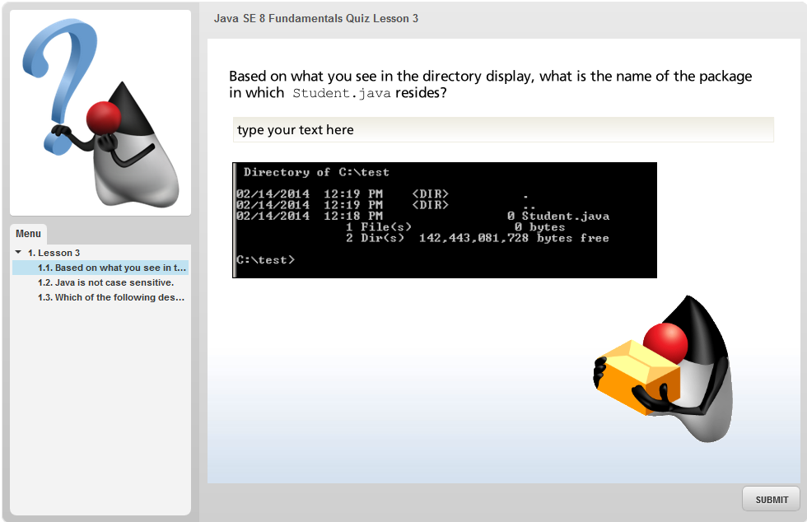
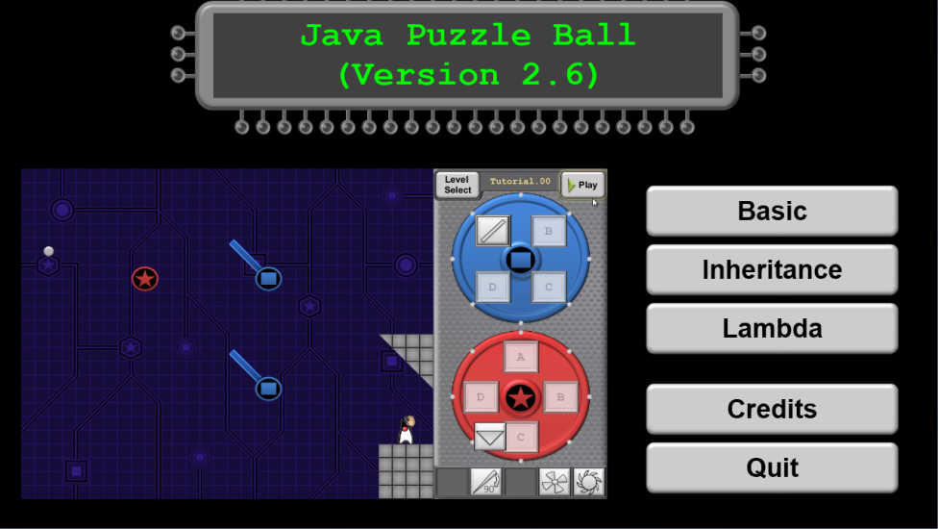
About This Course
12 Shirt myShirt = new Shirt();
13 Shirt yourShirt = new Shirt();
14
15 myShirt = yourShirt;
16
17 myShirt.colorCode = 'R';
18 yourShirt.colorCode = 'G';
19
20 System.out.println("Shirt color: “ + myShirt.colorCode);
Notes:
During this course, you will:
Write Java code using a code console and integrated development environment
Complete interactive quizzes
Play a game
Java SE 8 Fundamentals 1 - <number>

Slide 3
Audience
  Beginners to programming who have basic mathematical, logical, and analytical problem-solving skills and who want to begin learning the Java programming language
  Novice programmers and those programmers who prefer to start learning the Java programming language at an introductory level
  Students who want to begin their study of the Oracle Certified Java Associate exam
Notes:
The audience for this course is a beginner to programming who has basic mathematical and problem-solving skills. The course is targeted at technical writers, web developers, technical managers, project managers, program managers, and individuals with a technical, nonprogramming background such as system administrators.
Java SE 8 Fundamentals 1 - <number>

Slide 4
Course Objectives
After completing this course, you should be able to:
  Demonstrate knowledge of basic programming language concepts
  Demonstrate knowledge of the Java programming language
  Implement intermediate Java programming and object-oriented (OO) concepts
Notes:
Demonstrate knowledge of basic programming language concepts. For example, be able to describe the following:
Source code versus machine code
Platform dependence and platform independence
The use of APIs and libraries
Demonstrate knowledge of the Java programming language
Compile and run a Java program from both the command line and from NetBeans.
Create a Java class with fields and methods.
Declare and use arrays.
Use methods of the StringBuilder, String, and ArrayList classes.
Display and manipulate dates using one or two classes from the new java.time package.
Write conditional statements.
Write loop statements (enhanced for, for, while, do/while).
Write nested loops.
Implement a try block to handle exceptions.
Java SE 8 Fundamentals 1 - <number>

Slide 5
Notes:
Implement intermediate Java programming and object-oriented (OO) concepts
Instantiate an object and invoke its methods.
Explain how objects vs. primitive types or references are stored in memory.
Create a hierarchy of Java classes.
Implement inheritance by creating a subclass.
Overload a method and a constructor.
Encapsulate the fields of a class.
Use modifiers to control access to a field or a method.
Implement a Java Interface.
Create superclasses, abstract classes, and Interfaces and use them as reference types.
Use a Predicate lambda expression as the argument to a method.
Java SE 8 Fundamentals 1 - <number>

Slide 6
Schedule
Day One
  Getting Started
    Lesson 1: Introduction
    Lesson 2: What Is a Java Program?
  The Basic Shopping Cart
    Lesson 3: Creating a Java Main Class
    Lesson 4: Data in a Cart
    Lesson 5: Managing Multiple Items
Notes:
Java SE 8 Fundamentals 1 - <number>

Slide 7
Schedule
Day Two
  Filling the Cart
    Lesson 6: Describing Objects and Classes
    Lesson 7: Manipulating and Formatting the Data in Your Program
  Improving Cart Efficiency
    Lesson 8: Creating and Using Methods
Day Three
    Lesson 9: Using Encapsulation
  Expanding the Business
    Lesson 10: More on Conditionals
Notes:
Java SE 8 Fundamentals 1 - <number>

Slide 8
Schedule
Day Four
    Lesson 11: Working with Arrays, Loops, and Dates
  Bringing It Home
    Lesson 12: Using Inheritance
Day Five
    Lesson 13: Using Interfaces
    Lesson 14: Handling Exceptions
    Lesson 15: Deploying and Maintaining the Soccer Application
Notes:
Java SE 8 Fundamentals 1 - <number>

Slide 9

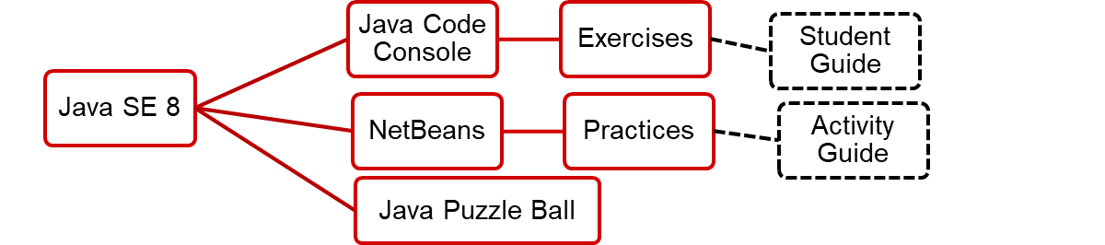
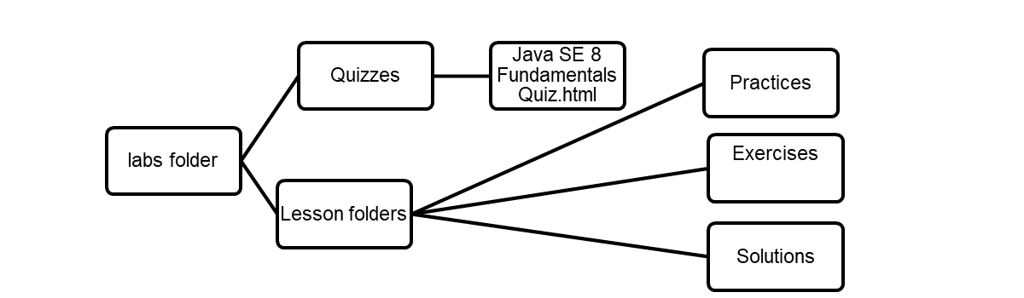
Course Environment
Classroom Computer
Notes:
In this course, the following products are preinstalled for the lesson practices:
JDK 8: The Java SE Development Kit includes the command-line Java compiler (javac) and the Java Runtime Environment (JRE), which supplies the java command needed to execute Java applications.
Firefox: A web browser is used to view the HTML documentation (Javadoc) for the Java SE Platform libraries.
NetBeans 8: The NetBeans IDE is a free and open-source software development tool for professionals who create enterprise, web, desktop, and mobile applications.
Student Guide: The guide contains the instructional material for all the topics discussed in class and includes appendices with additional information. It also includes some introductory instructions for completing the exercises and practices.
Activity Guide: These are resources to use during the practice portions of the course. The Activity Guide has instructions for completing the practices.
Lab Folder: The lab folder includes interactive quizzes, practices, exercises, and solution files.
Java SE 8 Fundamentals 1 - <number>

Slide 10
Notes:
Java API Documentation: The API documentation is the application programming interface specification.
Java Code Console: This is an IDE developed by Oracle Java Curriculum Developers that you use to perform short coding exercises.
Interactive Quizzes: The quizzes are self-paced and help you remember the key points learned in each lesson.
Java Puzzle Ball: This game is available for you to play on your machines. It will be used to introduce and reinforce concepts taught in the course.
Java SE 8 Fundamentals 1 - <number>

Slide 11

How Do You Learn More After the Course?
  To find more resources, bookmark the URL:
  Oracle.com/oll/java
  Look for the Java SE 8 Fundamentals Collection.
Notes:
In the Oracle Learning Library, there is a list of resources that you can use to learn more about Java programming. Look for the collection on the oracle.com/oll/java page.
Java SE 8 Fundamentals 1 - <number>

